Slide 1
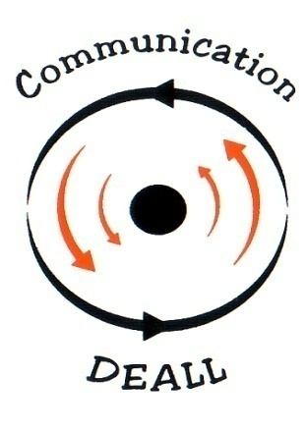
Cross validation of ComDEALL tools

Slide 2

Collaborative project

Slide 3
OVERVIEW

Slide 4
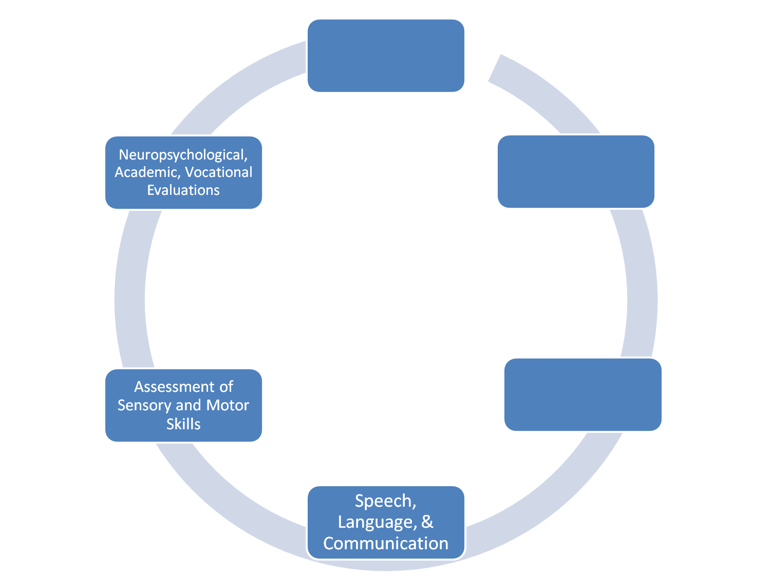

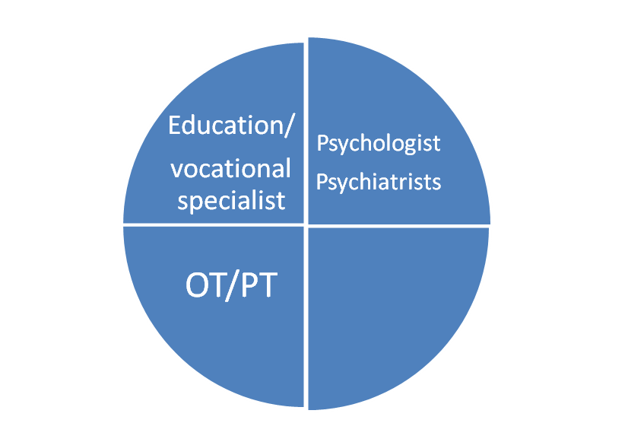
Cognitive/
Developmental/
Behavioral
Professionals involved
Developmental
History
SLP
Diagnostic
Assessment
Notes:
Assessment of individual with AD deals with 2 conditions:
1.Multitude of professionals
2. Multi dimensional assessments
Both are key to achieve a holistic picture of individual with autism
Although, every professional(within as well as across the disciplines) looks at the problem in a different manner thus resulting in different assessment tools available

Slide 5
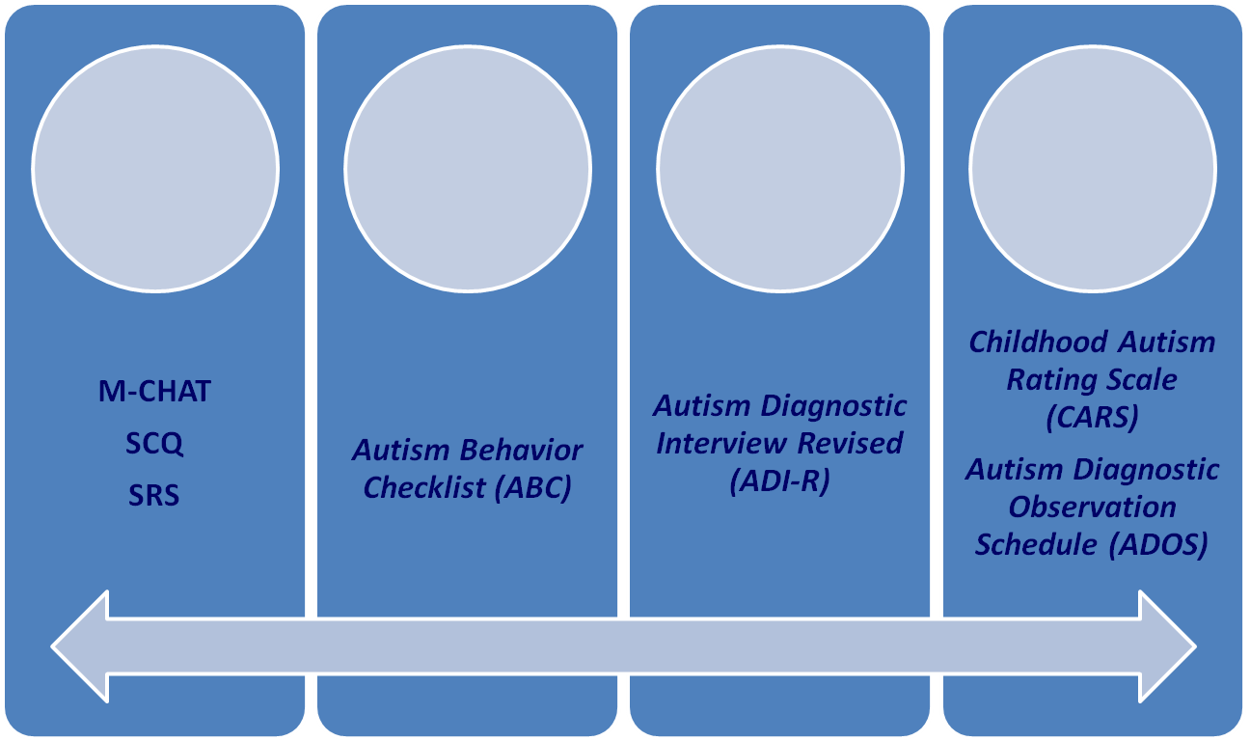
Standard assessment
Child
Observation
and Rating
Parent
Report
Teacher
Report
Parent
Interview
Notes:
Modified Checklist for Autism in Toddlers (M-CHAT)
Social Communication Questionnaire (SCQ); Social Responsiveness Scale (SRS)

Slide 6
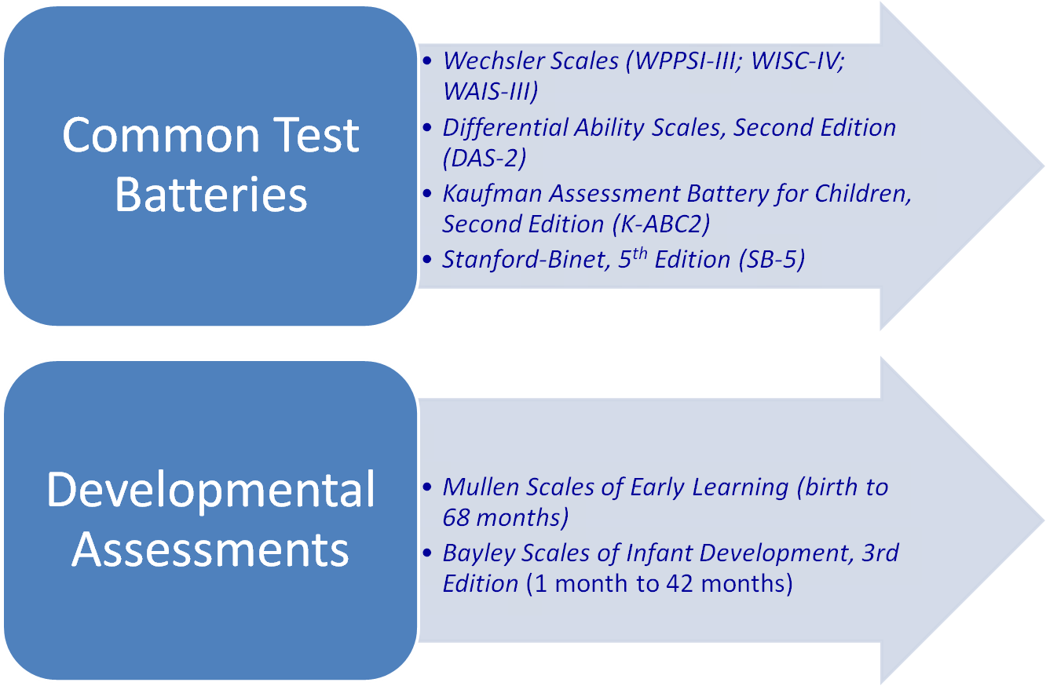
Standard assessment conti…
Notes:
As it is evident, most of these test assesses specific skill sets and doesnot address the child as a whole

Slide 7
NO………..battery approach
Can a single test describe children with ASD HOLISTICALLY?

Slide 8
…………performance of children with ASD with respect to typically growing age matched individuals
What are we achieving through assessments?
Notes:
Most of the test are standardized on typically growing individuals and our goal remains to assess children with ASD with these norms. Which can be very well achieved through developmental profiling.

Slide 9
………..baseline performance act as gold standard
………..greater need for in-house research for effective practice.
Do we have norms for Indian population? And what is the need?

Slide 10
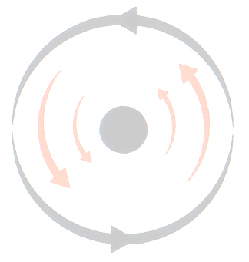
Importance of profiling
Developmental skills | GM | FM | ADL | RL | EL | Cog | Soc | Emo
Others
Sensory skills
Motor skills
PLS
Oro-motor skills
Pragmatic skills
Profiling individuals with developmental disabilities
  Developmental skills
  sensory/motor /pragmatic /PLS etc
Minimal work standardized on Indian population
Notes:
Most of the assessments lack cohesive understanding of the individual with autism. Our approach helps in building this connection between developmental skills with other skills set which influences the child’s overall behaviour/picture.
if we look at the assessment tools and intervention strategies, they generally address 1 issue i.e either they focus on development or behavioural problem, or just the triad of symptoms commonly seen, intervention for language skills, intervention for behavioural skills or oro-motor etc. But the program here talks about profiling the individuals, comparing the overlap between all of these skills and then coming up with a plan which helps in holistic improvement.

Slide 11
NEED FOR THE STUDY

Slide 12
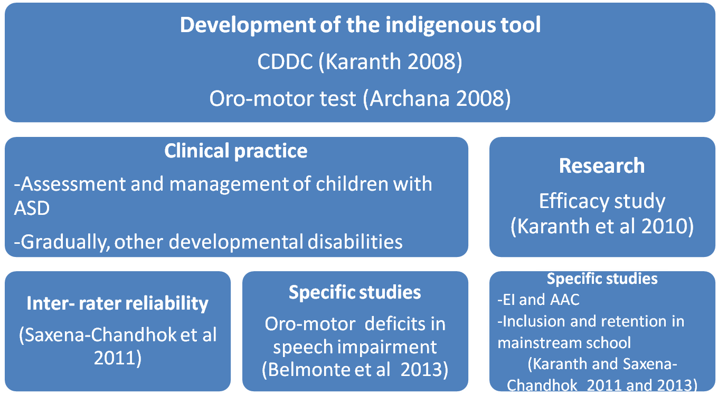
With the notion of early identification and intervention
Notes:
With the notion of early identification and intervention-----development of tool----by do such wide spread clinical as well as research work, we are reaching out to a wider audience who work with ASD and other developmental disabilities.
Thus, it is the need of the hour to compare our findings with other tasks used in west.
Such a study further gives us information about predictive validity of our tools

Slide 13
AIM

Slide 14
This study present data cross-validating developmental as well as oro-motor skills.
Basically, to assess com deall tools as compared to widely used western tools

Slide 15
Tools
Mullen 1995 Scale of early learning Observation Birth to 6 years | CDDC 2008 Developmental checklist Observation + caregiver information Birth to 6 years | VMPAC 1999 Verbal motor production in children Observation 3 -12 years | Oro-motor test 2008 Oro-motor skills in children Observation Since birth

Slide 16
Why did we choose Mullen and VMPAC for the comparison?

Slide 17
VMPAC is the only tool assessing oro-motor skills (similar to Oro motor test)
Mullen was closest to CDDC in terms of domain assessed.

Slide 18
Analysis
Cross-validation is a model validation technique for assessing how the results of a statistical analysis will generalize to an independent data set.
Correlation analysis
Factor analysis

Slide 19
Method
A sample of 260 typically developing individuals as well as 40 children with autism were considered for the study
Cross-sectional design
Participants | Number | Gender
Typical children | 260 | F-117 M-143
Children with Autism | 40 | F-11 M-32

Slide 20
PROCEDURE

Slide 21
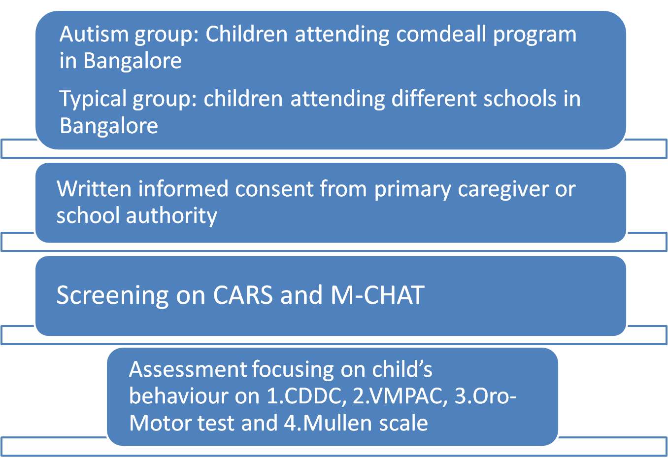

Slide 22
RESULTS

Slide 23


Factor analysis
 | Mullen | CDDC | Oro-motor | VMPAC
Component | 1 | 2 | 1 | 3
Variance | 77.15% | 55.6% | 69.41% | 54.3%
 |  | 22.61% GM skills |  | 14.2% General motor control
 |  |  |  | 9.3% Repetition
 | Mullen | CDDC | Oro-motor | VMPAC
Component | 1 | 1 | 1 | 3
Variance | 90.8% | 93% | 62.73% | 55.5%
 |  |  |  | 15.1% Singe sd
 |  |  |  | 11.1% Sentence level motor control

Slide 24
Correlation analysis
Mullen vs CDDC
Children with Autism
GM
VR
FM
RL
EL
GM | FM | ADL | RL | EL | Cog | Soc | Emo
.351 |  | .588 |  |  |  | .326
 | .374 | .505 | .731 | .601 | .637 | .610
 | .402 | .547 | .556 | .483 | .482 | .497
 | .303 | .568 | .748 | .628 | .594 | .661
 | .378 | .487 | .807 | .771 | .718 | .600 | .347

Slide 25
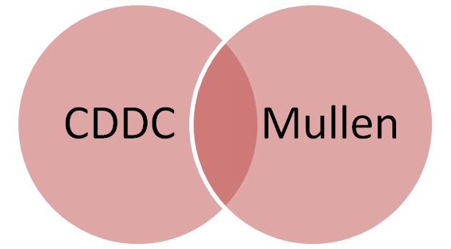
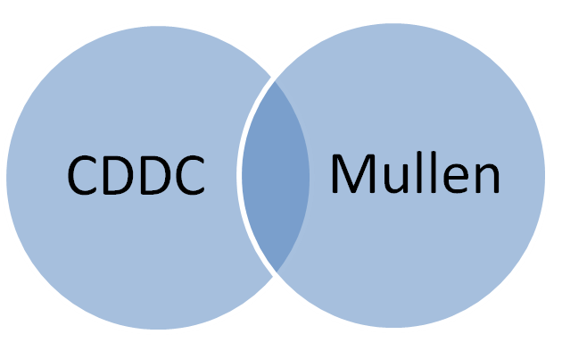
Regression analysis (total score)
Typical children
Children with Autism
79.4%
54.3%

Slide 26


Correlation analysis
Oro motor VS VMPAC
JM
TM
Sp
AC | NSTotal | SingleSd | DoubleSd | Triple Sd | SpeechMCS | SpeechSMS | Word Rep | Sen Rep | RepTotal | SenFor | SenCon
 | .202* |  |  | .311** |  | .233** |  |  |  |  | .295**
.300** | .499** |  | .357** | .514** | .170* | .429** | .315** | .176* | .235** | .240** | .621**
.332** | .504** |  | .277** | .334** | .258** | .267** | .422** | .490** | .506** | .521** | .287**
JM
TM
Sp
GMC | AC | DoubleNS | NS Total | SingleSP | DoubleSP | TripleSP | Sp MCS | Sp SMS | WR | SR | RT | SF | S MCS | AVS | SC
.459**
-.356* | .501** | .451** | .531** |  | .491** | .548** | .527** | .517** |  | .500** | .460** | .511** | .428* | .493**
-.483** | .627** | .508** | .625** | .605** | .717** | .708** | .761** | .707** | .403* | .693** | .705** | .574** | .617** | .761** | .408*

Slide 27
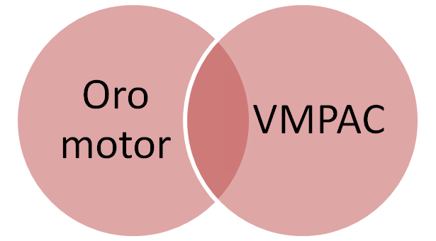
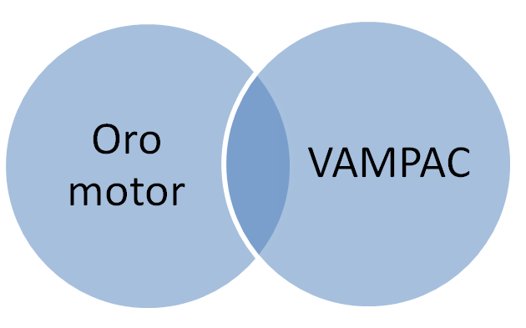
Regression analysis (total score)
Typical children
Children with Autism
43.3%
35.6%

Slide 28
Discussion
High correlation was seen between Mullen and CDDC
as well as
VMPAC and Oro motor
Evidence showing similar result while comparing Mullen with other tasks were also seen (Akshoomoff,2006; Zimmerman et al 1979, Mullen 1995)

Slide 29
The correlations with the Bayley Psychomotor Development Index were extremely varied between subscales – Gross Motor (0.76) to 0.28 (Visual Reception).
The language scales correlated strongly with other languages test; 0.85 (Receptive), 0.72 (Expressive) for Auditory Comprehension and 0.72 (Receptive), 0.80 (Expressive) for Verbal Ability (Mullen 1995)
Notes:
Our correlation also ranges from .80 till .303…..with language skills showing more correlation

Slide 30
It was also interesting to note that Gross motor skills shows lack of correlation with other developmental skills
GM standing out as an unique variable

Slide 31
Future direction
Further need to explore the amount of variance all the tests account for in both the population.
Developmental markers

Slide 32
Reference
Akshoomoff, Nataca (2006). Use of the Mullen Scales of Early Learning for the Assessment of Young Children with Autism Spectrum Disorders. Child Neuropsychology, 12(4-5): 269-277.
Mullen, Eileen M. Mullen Scales of Early Learning. Circle Pines, MN: American Guidance Services, Inc., 1995
Archana, G. (2008). A Manual from communicaid: Assessment of Oro Motor Skills in Toddlers. Bangalore:The Com DEALL Trust.
Karanth, P. (2007). CommunicationDEALL Developmental Checklists.Bangalore: The Com DEALL Trust.
Karanth, P. (2010). CommunicationDEALL–The Program. Bangalore:The Com DEALL Trust.
Karanth,P., Shaista, S.,and Srikanth,N.(2010). Efﬁcacy of CommunicationDEALL—An indigenous early intervention program for childrenwith autism spectrum disorders. Ind. J. Paediatr. 77, 957–962.
Belmonte et al 2013.Oral motor deficits in speech-impaired children with autism; Front. Integr. Neurosci., 01 July 2013 | doi: 10.3389/fnint.2013.00047

Slide 33
Thank you

